Slide 1
19AD784
IMAGE ANALYSIS AND COMPUTER VISION
Dr E Emerson Nithiyaraj
AP/ECE

Slide 2
Image Sensing and Acquisition
Image sensing involves the initial capture of light from a scene and its conversion into electrical signals. This is typically achieved using sensors such as charge-coupled devices (CCDs) or complementary metal-oxide-semiconductor (CMOS) sensors.
Image acquisition encompasses the entire process of capturing, digitizing, and storing images. It includes not only the physical act of sensing the image but also the preprocessing and formatting of the digital data for subsequent analysis or display.

Slide 3
Image Sensing and Acquisition
Illumination Source: This is the light that shines on the objects or scene. It could be natural light from the sun or artificial light from lamps or flashes.
Interaction with Scene Elements: When light hits objects in the scene, several things can happen:
Reflection: Light bounces off the surface of an object. The direction and intensity of reflection depend on the surface properties (like how smooth or rough it is).
Absorption: Some light energy is absorbed by the object, depending on its color and material properties. This absorbed energy may be converted into heat or cause changes in the object's appearance.

Slide 4
Image Sensing and Acquisition
Transmission: Light can pass through transparent or translucent objects, changing its direction and intensity as it does so.
Creating an Image: The camera captures this interaction. It records how light is reflected, absorbed, or transmitted by different objects in the scene. The combination of these interactions, along with how the camera sensor interprets light, forms the image that we see.

Slide 5
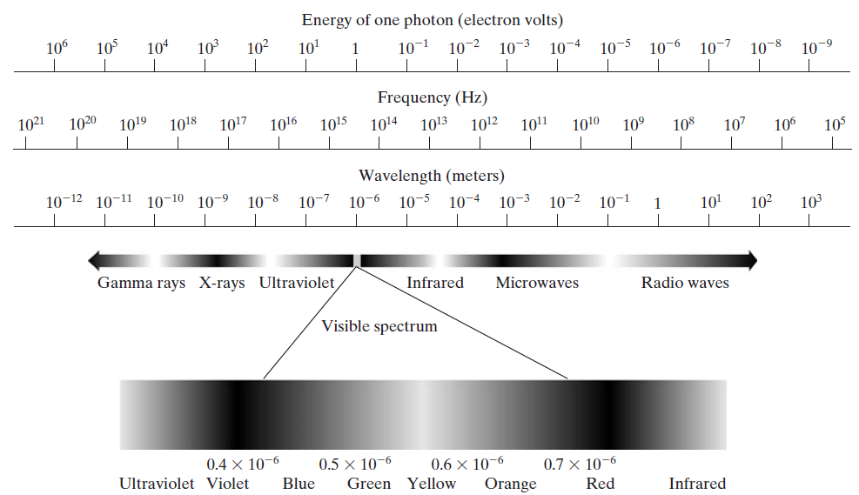

Slide 6
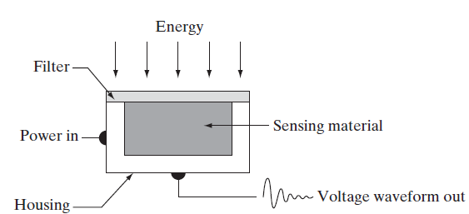
Single Imaging Sensor
Incoming energy is transformed into a voltage by the combination of input electrical power and sensor material that is responsive to the particular type of energy being detected.
The output voltage waveform is the response of the sensor(s), and a digital quantity is obtained from each sensor by digitizing its response.

Slide 7
Single Imaging Sensor
Photodiode - constructed of silicon materials; output voltage waveform is proportional to light.
The use of a filter in front of a sensor improves selectivity.
For example, a green (pass) filter in front of a light sensor favors light in the green band of the color spectrum.
As a consequence, the sensor output will be stronger for green light than for other components in the visible spectrum.

Slide 8
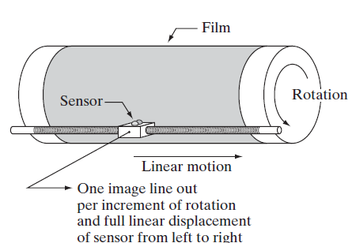
Single Imaging Sensor
In order to generate a 2-D image using a single sensor, there has to be relative displacements in both the x- and y-directions between the sensor and the area to be imaged.
A film negative is mounted onto a drum whose mechanical rotation provides displacement in one dimension. The single sensor is mounted on a lead screw that provides motion in the perpendicular direction.

Slide 9
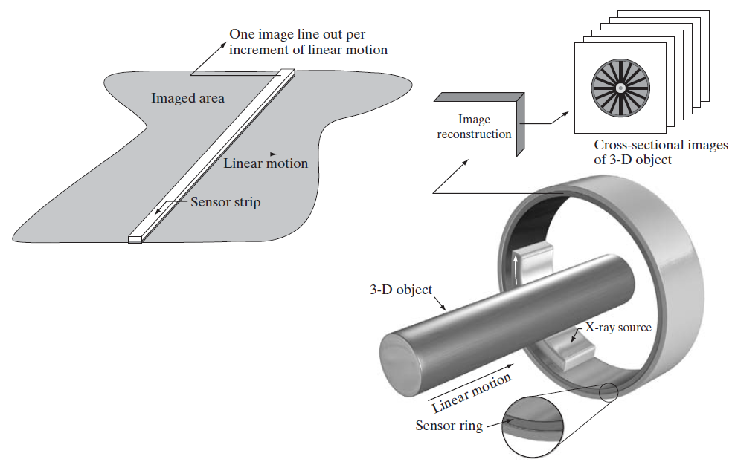
Image Acquisition Using Sensor Strips
In-line arrangement of sensors in the form of a sensor strip
Motion perpendicular to the strip provides imaging in the other direction
Sensing devices with 4000 or more in-line sensors are possible.
The imaging strip gives one line of an image at a time, and the motion of the strip completes the other dimension of a two-dimensional image.

Slide 10

Image Acquisition Using Sensor Arrays
Individual sensors arranged in the form of a 2-D array
Because the sensor array is two-dimensional, its key advantage is that a complete image can be obtained by focusing the energy pattern onto the surface of the array.
Motion obviously is not necessary.

Slide 11
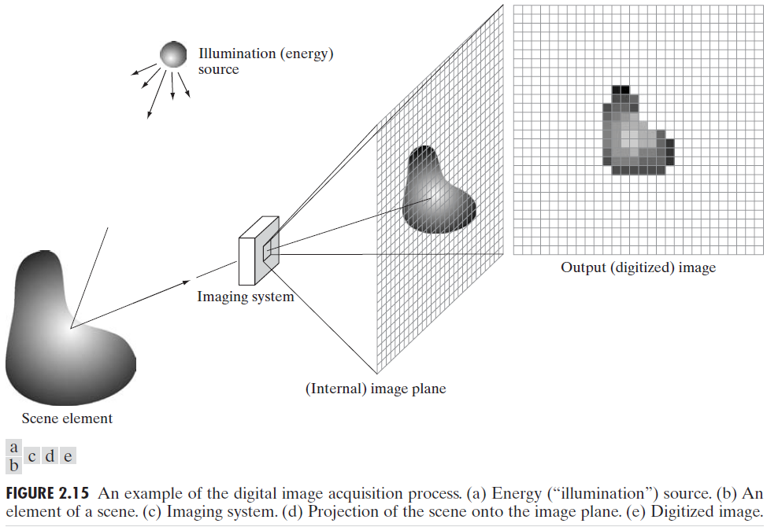
A Simple Image Formation Model

Slide 12

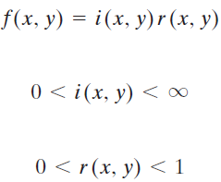
A Simple Image Formation Model
The function may be characterized by two components: (1) the amount of source illumination incident on the scene being viewed, and (2) the amount of illumination reflected by the objects in the scene. Appropriately, these are called the illumination and reflectance components and are denoted by and , respectively.
reflectance is bounded by 0 (total absorption) and 1 (total reflectance).
The nature of i(x,y) is determined by the illumination source, and r(x,y) is determined by the characteristics of the imaged objects.

Slide 13
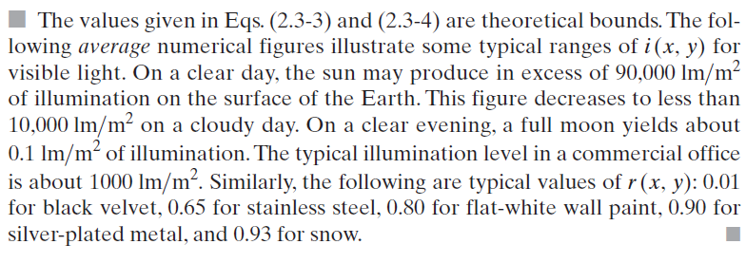
A Simple Image Formation Model

Slide 14
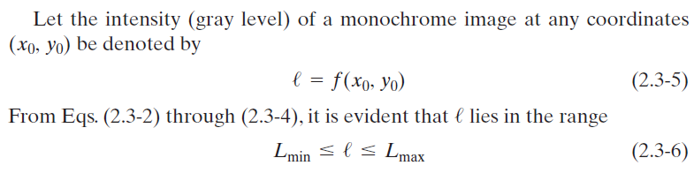
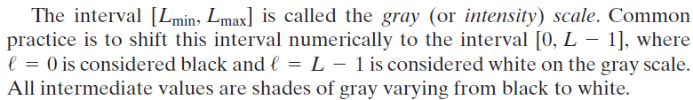
A Simple Image Formation Model

